Slide 1


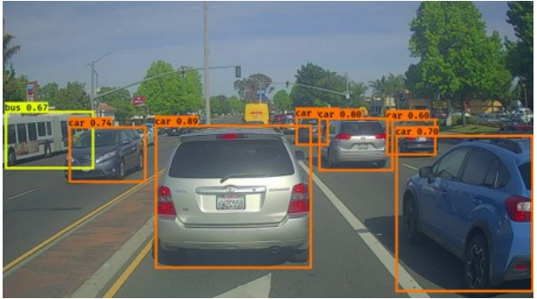
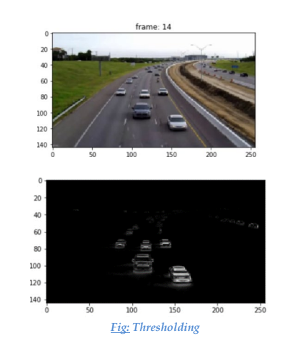
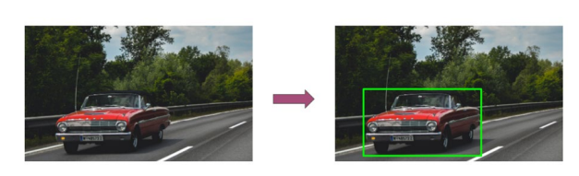
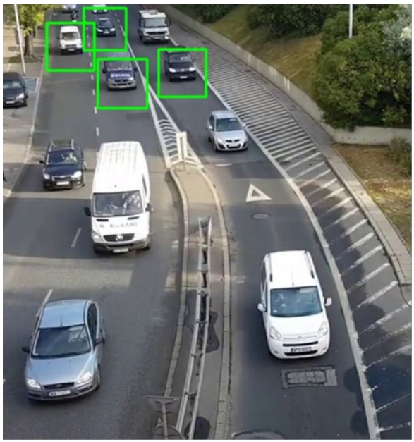
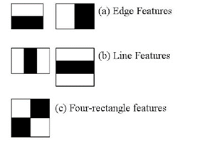
Team AVIDA
Vehicle Detection
1.Hareesh M. 2. Shivansh Mishra 3. Thanesh Bisen
Abstract
Methodology
Conclusions
In this project, our aim is to study about real-time vehicle detection and try to incorporate the feature in our autonomous vehicle model by writing a code, implementing crucial machine learning concepts. We used OpenCV to isolate pixels and perform various image and graphics related operations worked with Cascade Classifier for object detection.
Our objective is to capture the coordinates of the moving object and highlight that object in the video. Overall, we were able to use, understand and modify the above piece of code and implement it on raw video feed and easily create our own vehicle detection pipeline.
Computer Vision
Thresholding
Cascade Classifier
1. Using OpenCV to isolate pixels and perform various image and graphics related operations.
2. Using Computer Vision ML techniques and learning the use various classification techniques utilized in Computer Vision.
3. Working with Cascade Classifier for object detection.
4. Learning about reducing time and improving accuracy by using pre-trained models in supervised learning.
Overall, we were able to use, understand and modify the above piece of code and implement it on raw video feed and easily create our own vehicle detection pipeline.
Results
The image below is a still frame from the output
video feed after the program was run:
Introduction
Computer Vision
Image pre-processing
Dataset Creation
Thresholding
Grey Scale Image
Scale Factor
Cascade Classifier
Rapid Object Detection
HAAR Feature
Real-time vehicle detection is one of the many application of object detection, whereby focuses on detecting cars within an image together with the location coordinates.
Vehicle detection together with road detection is heavily applied on self-driving cars, for a car to navigate safely along the road, it has to know where other cars are positioned so as it can avoid a collision.
In addition, vehicle detection is being used in traffic surveillance systems in such a way it can detect the traffic based on number vehicle and use that
data to manage and control it. Computer vision is one of the hottest topics in Artificial Intelligence. It is being used extensively in Robotics, Autonomous Vehicles, Image Classification, Object Detection & tracking, Semantic Segmentation as well as in various photo correction apps. In Autonomous vehicles, vision remains the main source of information to detect lanes, traffic lights, and other visual features.
Our objective is to capture the coordinates of the moving object and highlight that object in the video.
Figure 1. Vehicle Detection rear view
Figure 1. Vehicle Detection
Figure 1. HAAR feature
Contact
References
Team AVIDA
Team Id – SDCC2021001
National Institute of Technology, Agartala.
LinkedIn: Team Avida/LinkedIn2021
Phone:7905155527
• https://www.codespeedy.com/vehicle-detection-in-python-using-opencv/
• https://pyimagesearch.com/2019/12/02/opencv-vehicle-detection-tracking-and-speed-estimation/
• https://dev.to/kalebu/how-to-perform-real-time-
vehicle-detection-in-python-4i9h
• https://techvidvan.com/tutorials/opencv-vehicle-
detection-classification-counting/
• https://www.analyticsvidhya.com/blog/2020/04/ve
hicle-detection-opencv-python/
• https://dev.to/kalebu/how-to-perform-real-time-
vehicle-detection-in-python-4i9h

